Slide 1

Cross-sell Prediction

Slide 2

Cross-selling identifies products or services that satisfy additional, complementary needs that are unfulfilled by the original product that a customer possesses.
Just like medical insurance, there is vehicle insurance where every year customer needs to pay a premium of certain amount to insurance provider company so that in case of unfortunate accident by the vehicle, the insurance provider company will provide a compensation (called ‘sum assured’) to the customer.

Slide 3

Building a model to predict whether a customer would be interested in Vehicle Insurance is extremely helpful for the company because it can then accordingly plan its communication strategy to reach out to those customers and optimise its business model and revenue.

Slide 4

Variable | Definition
id | Unique ID for the customer
Gender | Gender of the customer
Age | Age of the customer
Driving_License | 0 : Customer does not have DL, 1 : Customer already has DL
Region_Code | Unique code for the region of the customer
Previously_Insured | 1 : Customer already has Vehicle Insurance, 0 : Customer doesn't have Vehicle Insurance
Vehicle_Age | Age of the Vehicle
Vehicle_Damage | 1 : Customer got his/her vehicle damaged in the past.
 | 0 : Customer didn't get his/her vehicle damaged in the past.
Annual_Premium | The amount customer needs to pay as premium in the year
Policy_Sales_Channel | Anonymised Code for the channel of outreaching to the customer ie. Different Agents, Over Mail, Over Phone, In Person, etc.
Vintage | Number of Days, Customer has been associated with the company
Response | 1 : Customer is interested, 0 : Customer is not interested

Slide 5

Target Data is Classification
Decided to implement Classification algorithm
Pre-processing :
No NA fields present in the Train and Test file
Based on the correlation decided to remove some fields
"Vehicle_Age",
"Annual_Premium",
"Policy_Sales_Channel"

Slide 6

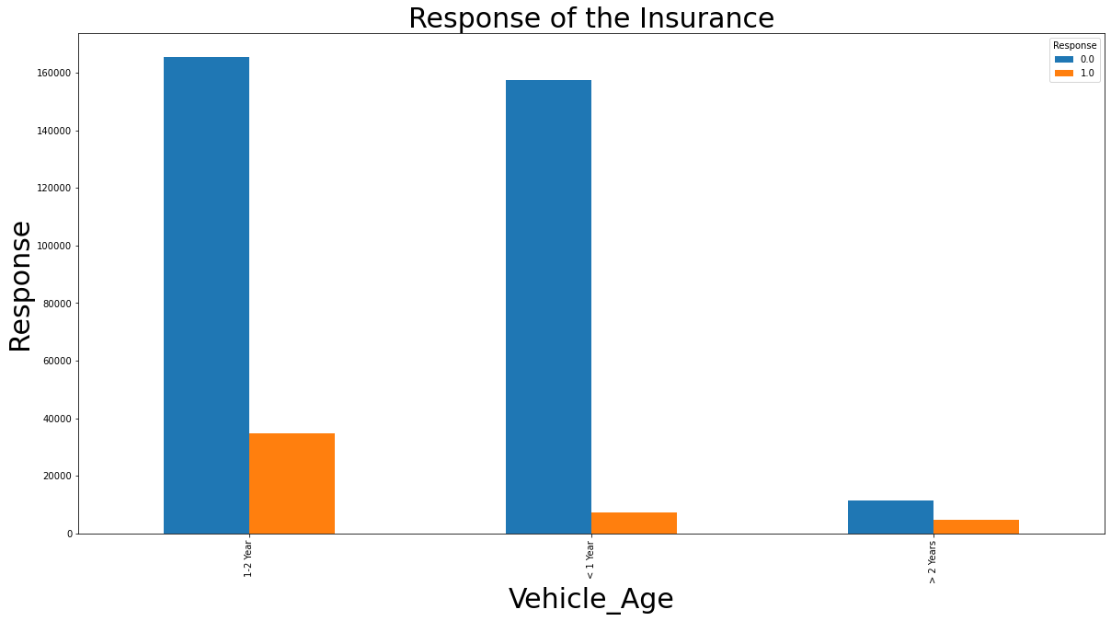

Slide 7

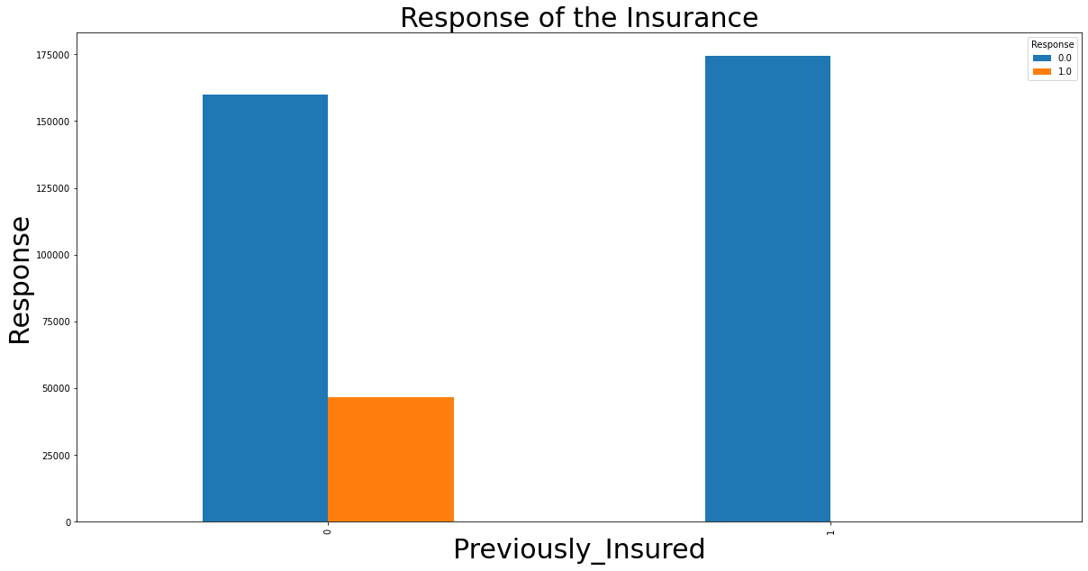

Slide 8

Female 0.0 156835
1.0 18185
Male 0.0 177564
1.0 28525

Slide 9

Initially implemented with the logistic model
but not able to get proper F1 score
Then tried with other models even though score is not increased in the forum
So found ratio of response is not properly aligned
Did under sampling of the train data based on response
And tried with XGBOOST and came up with the proper score

Slide 10

